Slide 1

Canine and Feline CPR and First Aid
For Grooming Professionals

Slide 2

Important Notes
This class in no way is a replacement for veterinary care
For liability reasons our company does not provide advice on any over the counter medications or prescriptions for pets
Even though providing CPR and emergency first aid to a pet can save its life, we cannot guarantee its success in all instances
Certification is valid for 2 years
Ebooks browser hosted, cannot be downloaded nor printed

Slide 3

Preventing Medical Emergencies
Regular Check-Ups
Importance: Early detection of potential health issues.
Action: Schedule annual or bi-annual vet visits.
Proper Nutrition
Importance: Maintains health and prevents obesity-related diseases.
Action: Consult with a vet for a balanced diet plan.
Exercise and Enrichment
Importance: Keeps pets physically and mentally stimulated.
Action: Daily exercise routines and interactive toys.
Safety Measures
Importance: Prevents accidents and injuries.
Action: Secure hazardous items, use pet-proofing techniques at home.
Training and Behavior
Importance: Reduces risk of aggressive or fearful reactions.
Action: Regular training sessions and socialization.

Slide 4
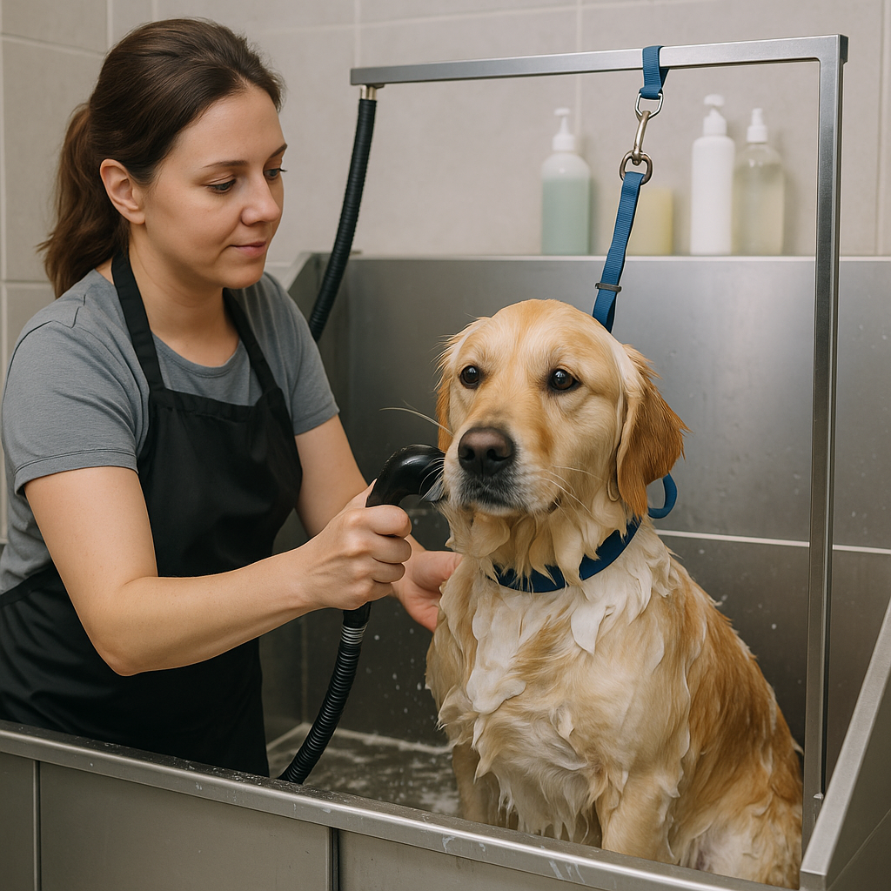
Tips for Groomers
Don't rush
Create a routine and stick to it
knee should never be lifted higher than hip
Front leg is lifted to front or back, not to the side.
Move the table, not the animal whenever possible
Set the grooming loop to hold the dog in place.
Use clean sharp blades to avoid excessive pressure or repetitive clipping
Keep your blades and scissors in good condition
Don't cut corners
Use only appropriate equipment
NEVER leave an animal unattended on the table or in the tub
Cats are not dogs, make sure you are trained
Know your salon's emergency protocol.

Slide 5
Anxiety and Stress
Symptoms
What to Do
Pacing/shaking
Whining/vocalizing
Drooling
Changes in eye appearance
Excessive shedding
Panting
Avoidance behaviors
Hiding or escaping
Remove them from the cage and take their vital signs
If overheating, put them in a cooler area of the salon.
Keep away from other animals
Do not leave unattended
If no improvement in 15 minutes contact owner (recommend contacting veterinarian)

Slide 6
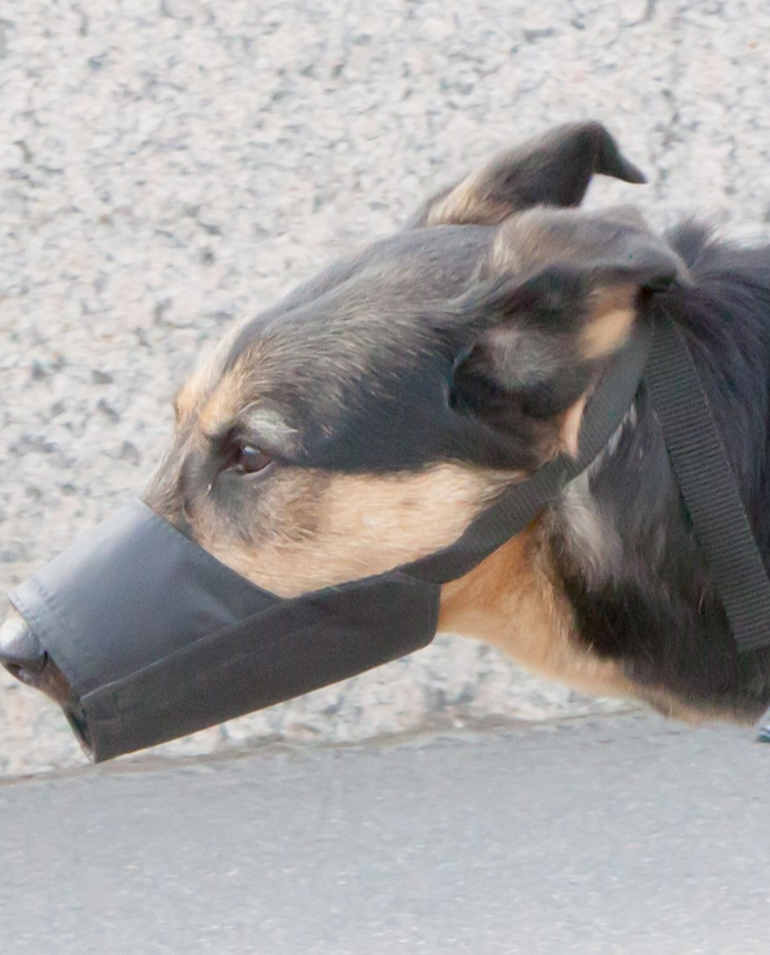
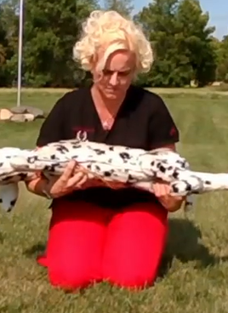


Handling an Injured Pet
Consider muzzling an aggressive Pet- Muzzles are a good tool to use to protect yourself from harm.
Stabilize Before Moving- Avoid further injury by gently stabilizing fractures or severe wounds with makeshift splints or bandages.
Use a Pet Carrier or Stretcher- For small pets, use a carrier. For larger pets, improvise a stretcher using a board or blanket to support their weight evenly.
Minimize Stress- Keep the environment calm and quiet to prevent stress, which can exacerbate the pet's condition.
Head to the Vet Immediately- Drive carefully to the nearest vet or emergency animal hospital, calling ahead if possible to prepare them for your arrival.

Slide 7
Triage- Prioritizing Medical Need
Level 1: Immediate (Life-Threatening)
Cardiac Arrest: No pulse, no breathing.
Severe Bleeding: From a major artery or large blood loss.
Major Trauma: Such as being hit by a car, resulting in multiple fractures or internal bleeding.
Level 2: Emergency (Needs Quick Intervention)
Difficulty Breathing: Choking or severe asthma attacks.
Open Fractures: Bone visibly protruding through the skin.
Profound Shock: Pale gums, rapid but weak pulse, very low blood pressure.
Level 3: Urgent (Serious but Not Immediately Life-Threatening)
Deep Lacerations: Requiring sutures but not spurting blood.
Moderate Shock: Signs of distress but somewhat stable vitals.
High Fever: Accompanied by signs of pain or distress.
Level 4: Less Urgent (Needs Medical Attention but Can Wait)
Mild to Moderate Lameness: Possibly due to sprains or minor fractures.
Skin Infections or Minor Burns: Not involving a large area of the body.
Low-grade Vomiting or Diarrhea: Without blood and the pet is otherwise behaving normally.
Level 5: Non-Urgent (Minor care)
Minor Cuts and Scrapes: Superficial and not bleeding significantly.
Chronic Conditions: Stable but needing routine follow-up, such as arthritis or mild allergies.

Slide 8
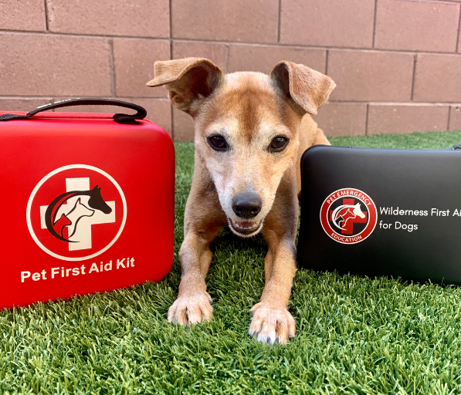
Pet First Aid Kit
Pet Thermometer specifically designed for animals
Stainless Steel Bandage Scissors
Stainless Steel Forceps
Blood Clotting Stick
CPR Barrier Mask for dogs and cats
Pair of Disposable Gloves
Leg Splints
Antiseptic
Alcohol Wipes
Sterile Gauze Squares
Cotton Balls
Rolled Conform Bandage
Porous Medical Tape
Adhesive Bandage
Thermal Survival Blanket
Oral Dosing Syringe
Ice Pack
Cotton Swabs

Slide 9
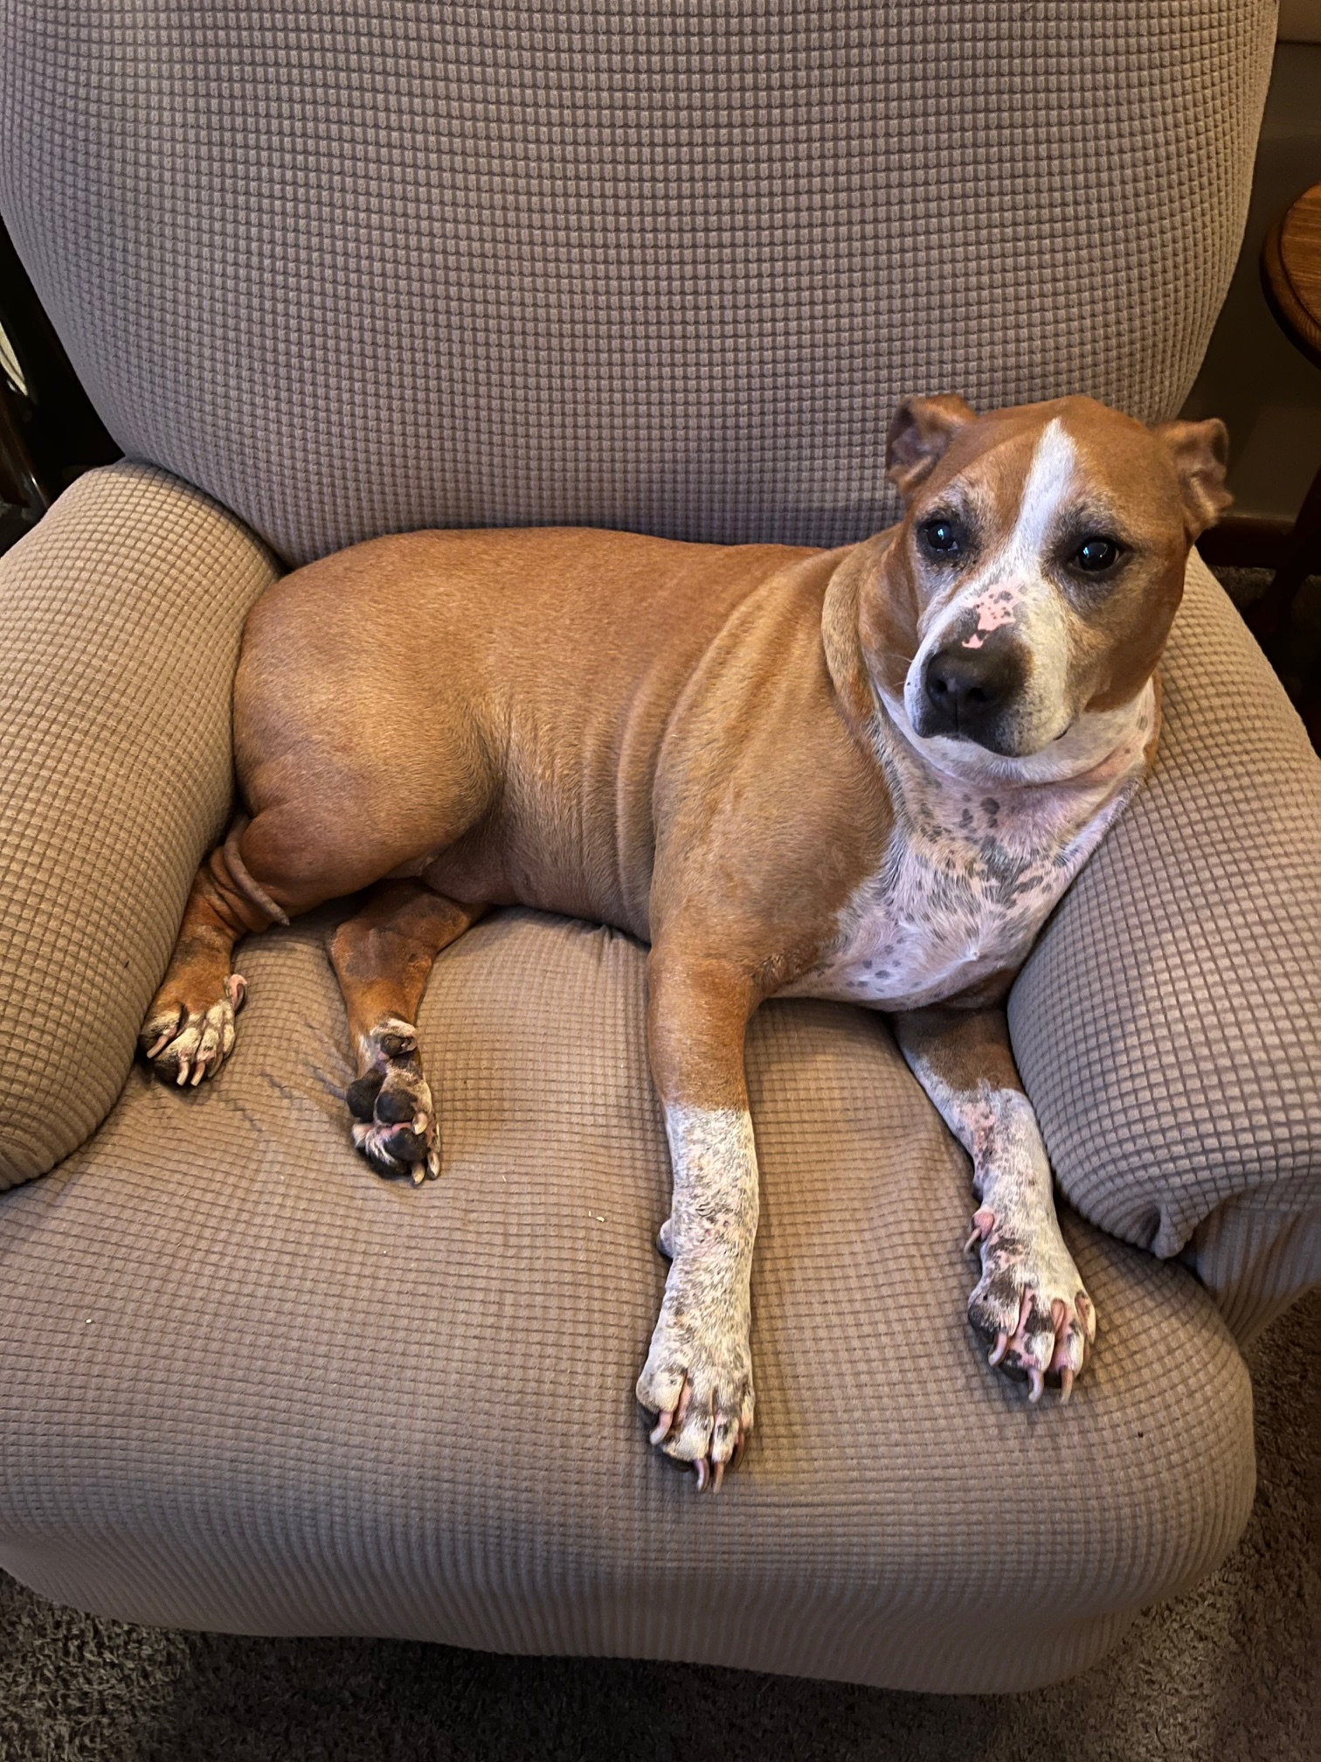
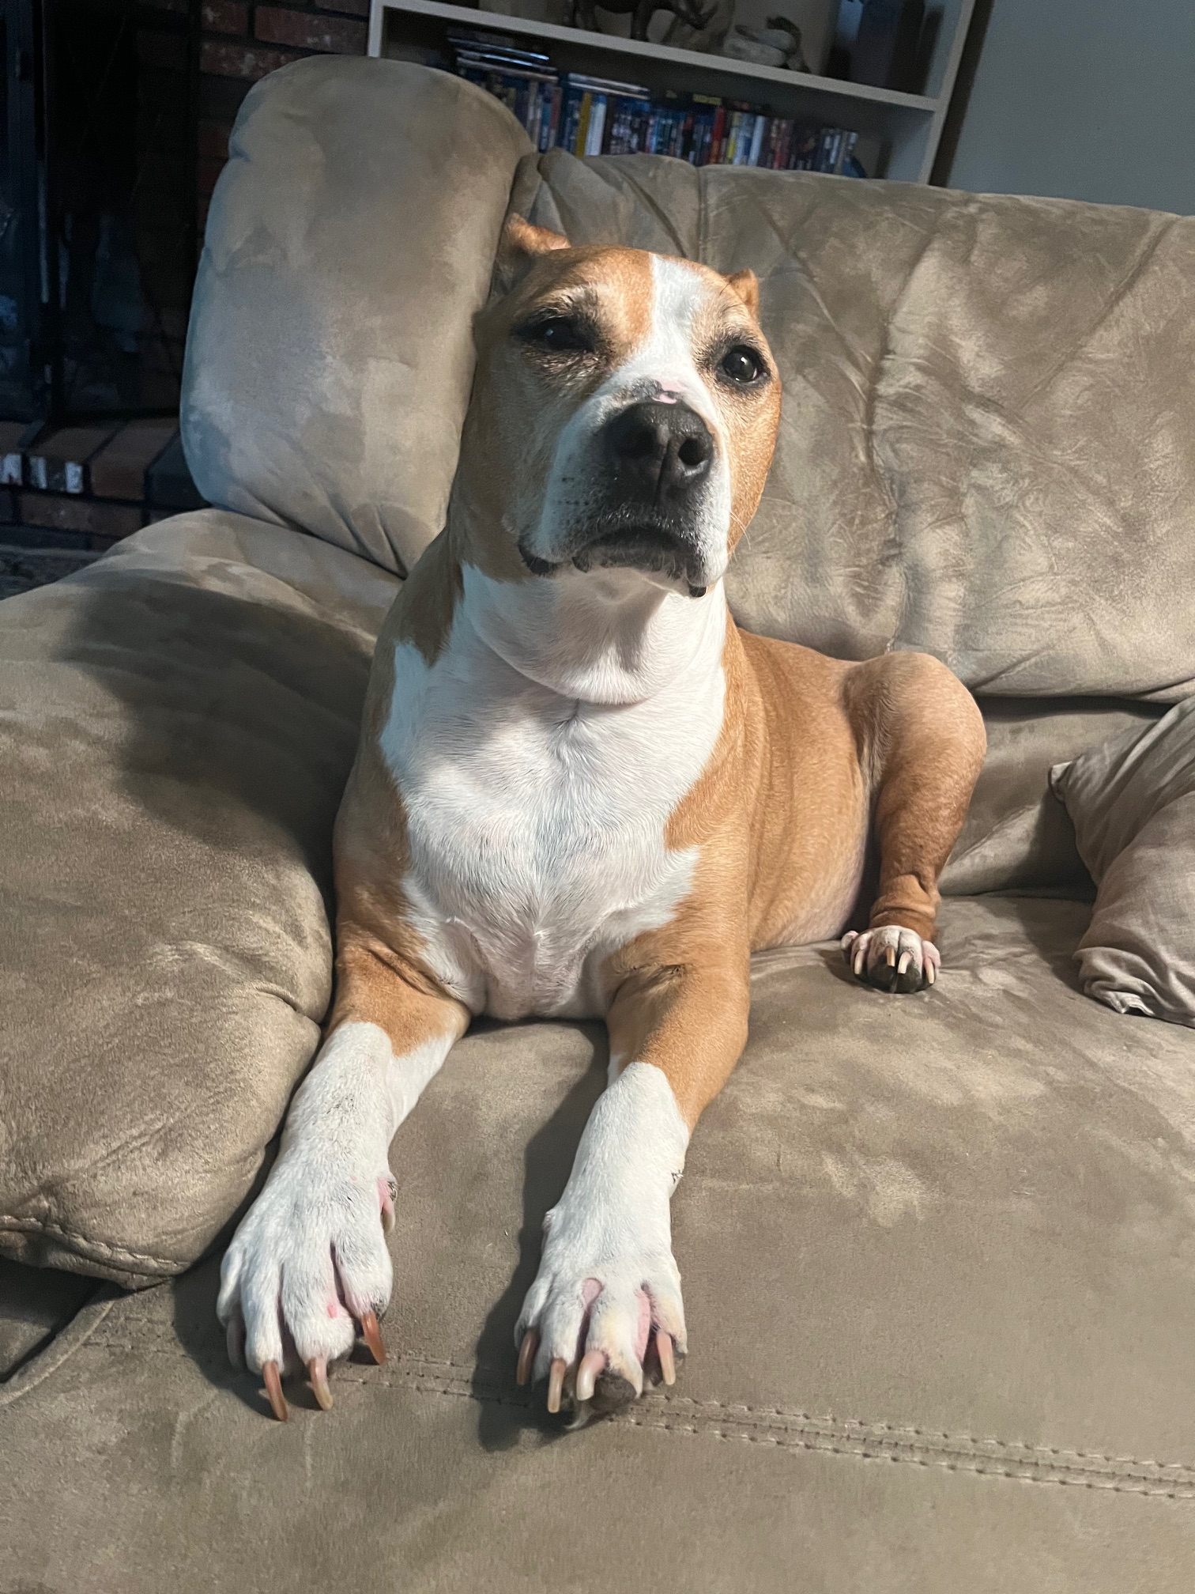
Allergic Reactions
Dog with Skin Allergies Before Treatment
Signs and symptoms
Collapse
Difficulty breathing
Pain, itching, licking
Bumps, redness or hives
First Aid
Cold compress
If topical reaction, wash with oatmeal shampoo
Contact Veterinarian for potential antihistamine medication
Dog with Skin Allergies After Treatment

Slide 10
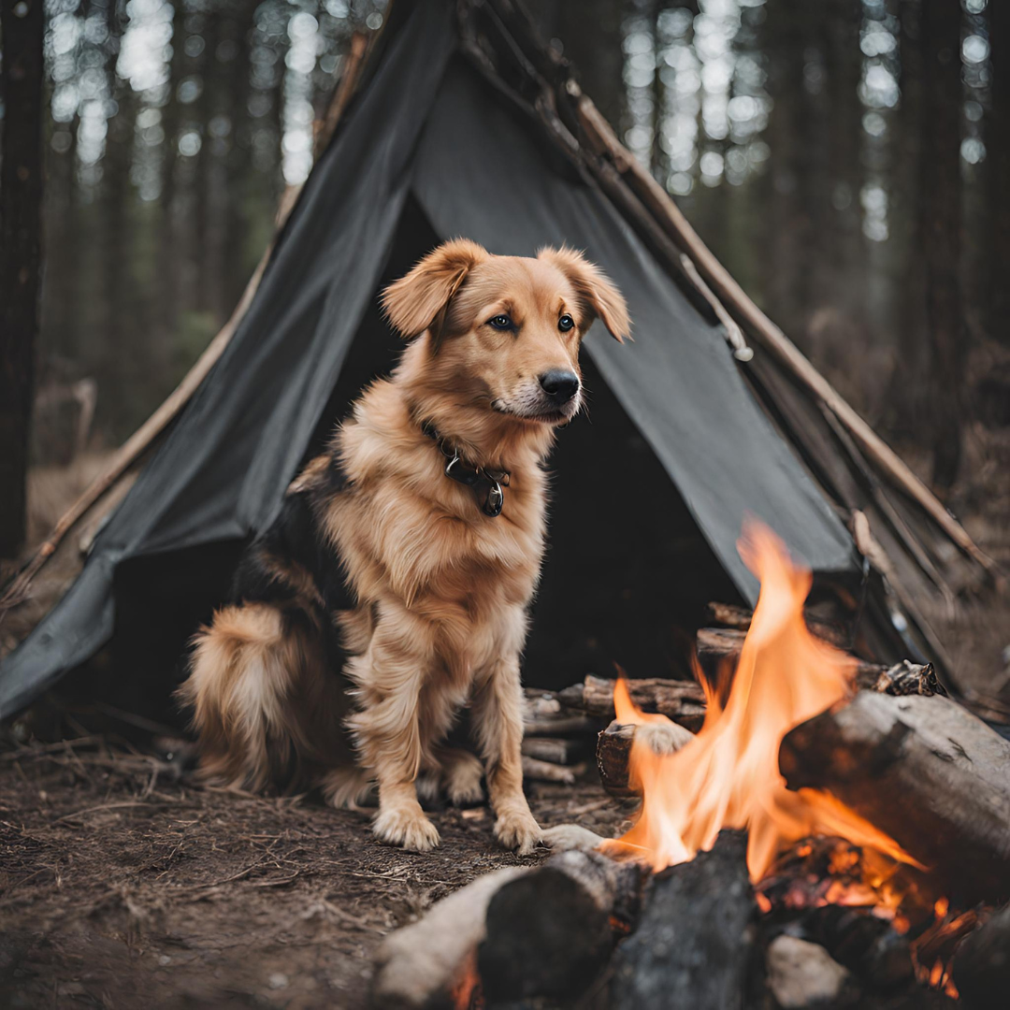
Burns
All burns should be taken seriously, and you should contact your veterinarian immediately
Types of Burns
Thermal burn- Caused by heat; common causes include fire, smoke, or steam
Electrical burn- Caused by electrocution
Chemical burn- Caused by contact with a chemical or chemical fumes; common causes include acids, drain cleaners (lye), gasoline, and paint thinners
Immersion in cool water or saline (salt and purified water) or spraying the affected area with cool water or saline.
Silver sulfadiazine
Burn Cream

Slide 11
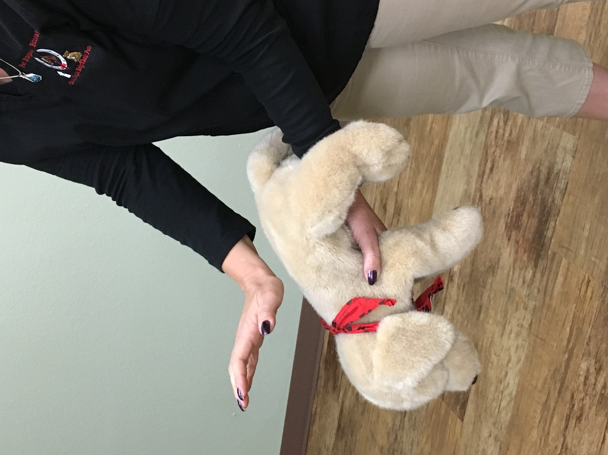
Positions for Choking Animals
Back Blows
Hold small animals on forearm (pictured) and use palm of other hand to hit between the shoulder blades
Abdominal Thrusts
4 quick thrusts upward to abdomen

Slide 12
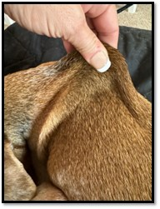
Dehydration
Defined as a lack of water in the body
Symptoms
Dry mouth
Depression
Sunken eyes
Lethargy
First Aid
Perform Skin Turgor Test
a measure of skin elasticity, or the ability of skin to change shape and return to normal.
Offer water (not too cold)
If the pet will not drink, try to offer some water with an oral syringe
Seek veterinary attention right away for severe dehydration

Slide 13
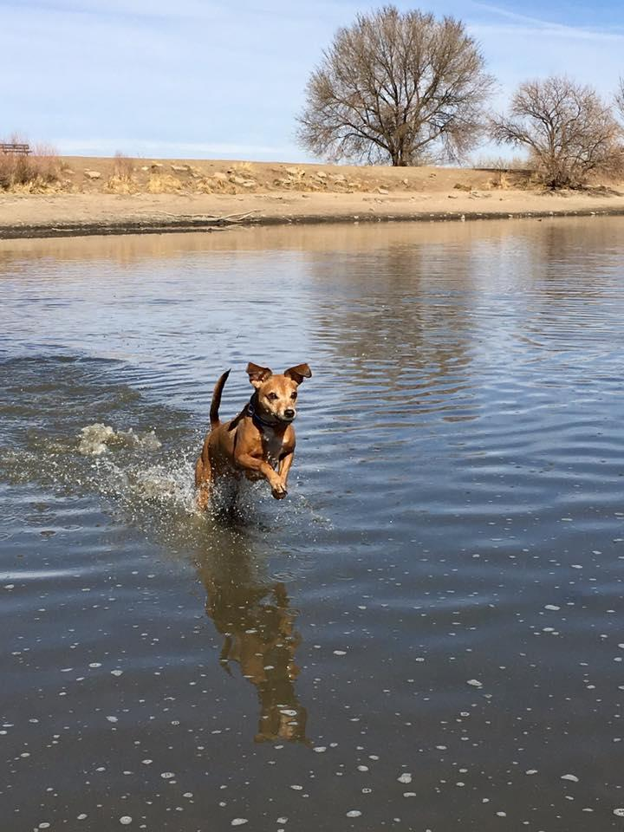
Drowning
Safely remove the animal from the water first and then check for consciousness.
If the animal is not breathing, lift the animal by the hind legs to allow water to come out of the nose and/or mouth.
Lay the animal down on either side with the head lowered. Go through the series of A,B,C before performing CPR or rescue breathing.
Get to a veterinary clinic as soon as possible.

Slide 14

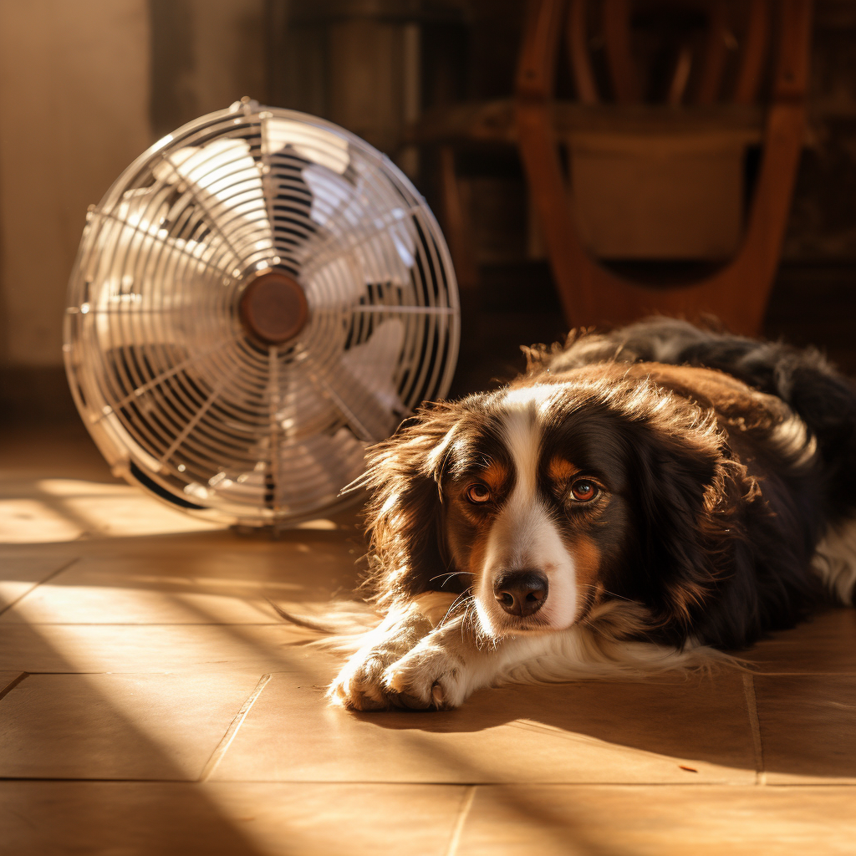
Hypothermia and Hyperthermia
Body temperature too low
Pale gums, cold to touch, lethargic
Body temperature too high
Excessive panting, red gums, collapse

Slide 15


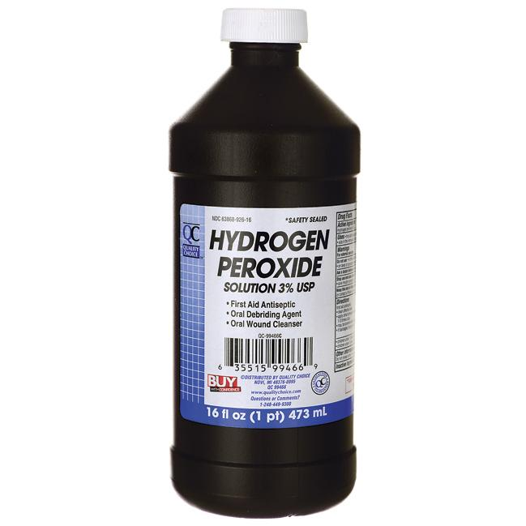
Poisoning
You should ALWAYS contact a veterinarian or emergency veterinary clinic before administering first aid for poisoning
Possible Symptoms:
Depression, weakness, trouble breathing, vomiting, facial and paw swelling, nausea, vomiting, diarrhea, abdominal pain, seizures, loss of coordination and disorientation, increased water intake and increased urination, excitation, salivation, foaming at the mouth, drooling, shallow respiration, collapsing, pale mucous membranes, coughing and swollen joints.
First Aid:
You can induce vomiting within 20 minutes of ingesting a poisonous item however this is not recommended for brachycephalic breeds or pets with a history of cardiovascular disease or seizures.
Activated charcoal such as VetDtox binds toxins in the digestive tract, preventing them from being absorbed into the bloodstream.
DO NOT induce vomiting unless you know what the toxin is and NEVER give hydrogen peroxide to cats!

Slide 16
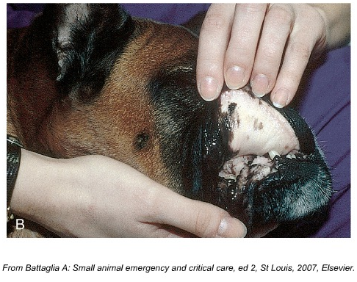
Shock
What is Shock?
A serious condition where the body doesn’t get enough blood flow, causing vital organs to lack oxygen.
Can result from injury, blood loss, allergic reactions, or illness.
Signs of Shock:
Pale gums, weak pulse, rapid breathing
Cool ears, paws, or tail
Lethargy or loss of consciousness
What to Do:
Keep the pet warm
Lower the head so it is lower than the heart
Transport to a veterinary hospital immediately
Monitor breathing and heart rate
Copyright © 2011 Mosby Inc an affiliate of Elsevier Inc. Reprinted with permission

Slide 17
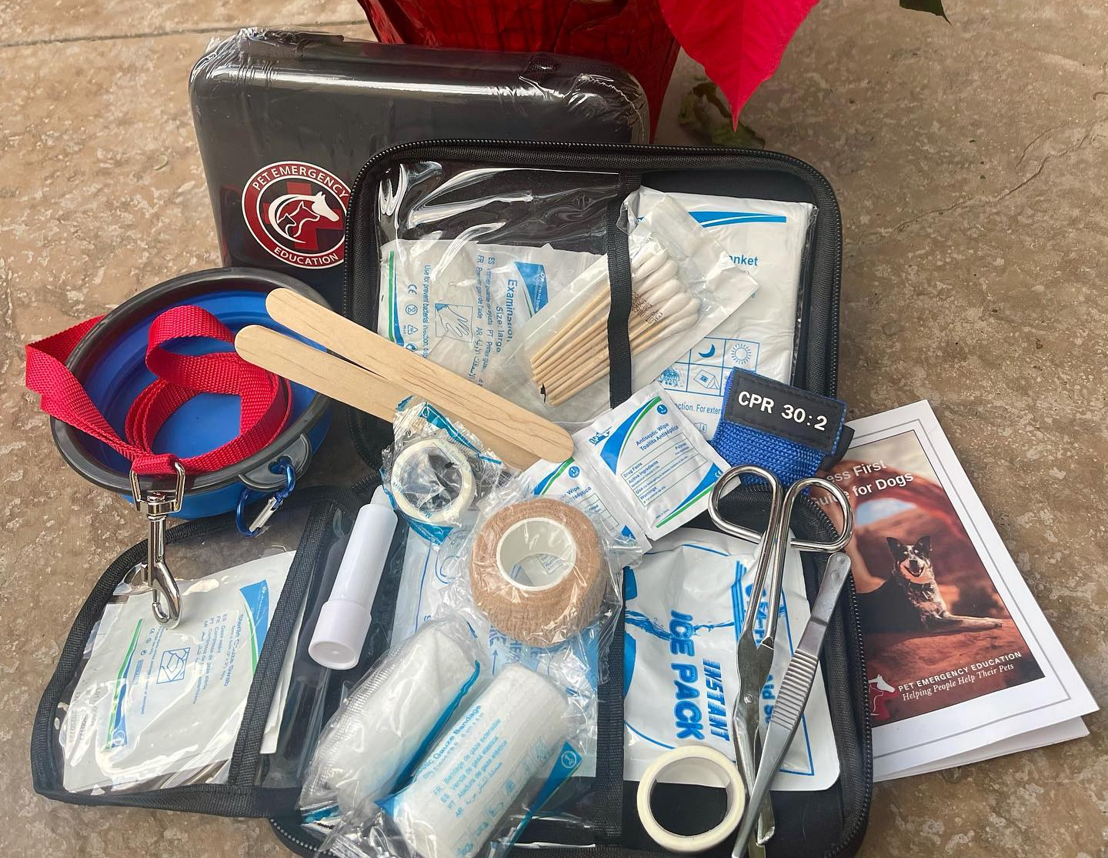
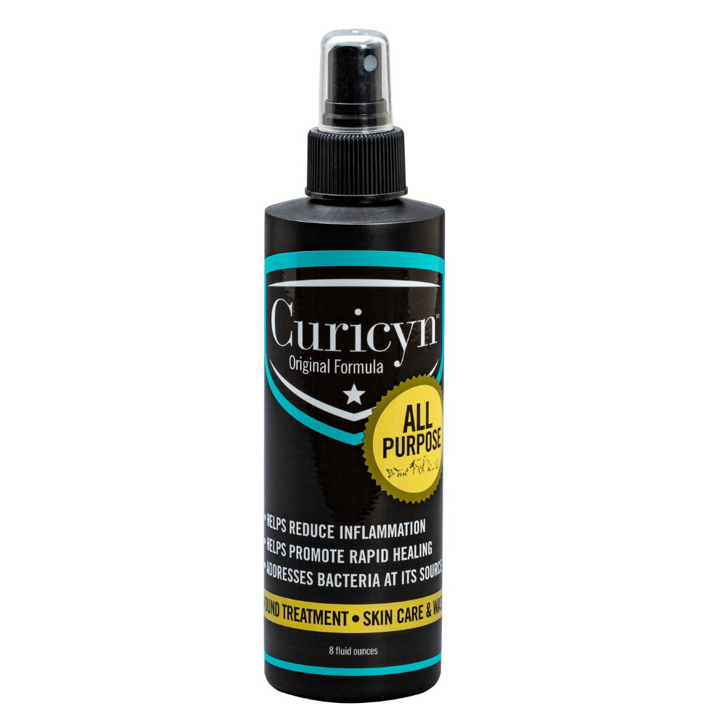
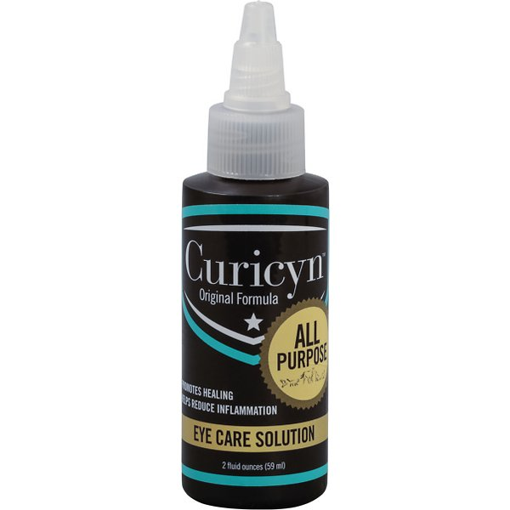
Wounds
Types of wounds
Abrasions
Lacerations
Bite wounds
Fractures
Breaks
Contusions
First Aid Supplies
Antiseptic
Bandage Material
Splints
Visit our Resource Center for video tutorial on how to apply emergency bandages on dogs and cats

Slide 18
Common Skin Injuries in a Salon
Ear Knicks
Apply pressure until the bleeding stops. 2-5 minutes.
Use clean gauze pads, bleeding more than 5 min may need styptic powder
Larger cuts may need sutures
Frail Skin
Older dogs and cats
If only a couple of and not bleeding, it is most likely a surface scrape.
If bleeding and/or longer in length, then a vet visit is advisable.
Advisable that instead of using the shortest blade, go for the shortest comb cut, that way the comb will act as a guard on the skin and you can avoid any accidental cuts.
Mats
tightly tangled clumps of fur
Keep the fur dry. Water can make the mat set tighter
Options: Detangler, wide tooth comb and patience
Hold fur closest to skin to control resistance from brushing

Slide 19
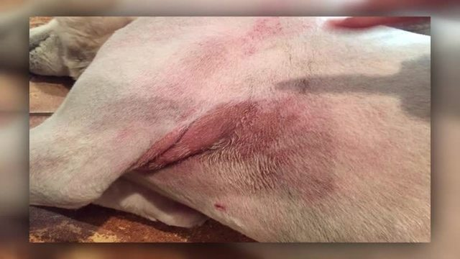
Clipper Burn
What to Do
Cause
Also referred to as razor burn and causes an irritating rash on the skin
Blade too dull or has broken teeth
Overheated clippers
Clipping too close to skin
Have first aid product like Vetericyn available to put on the wound
Try to prevent animal from licking at the rash
Triple antibiotics are OK to us but only use ointments. Creams have more additives that animals can have a reaction too. Do not use ones with painkillers. They are toxic.
Severe reactions, open skin wounds and discharge warrant going to the vet

Slide 20
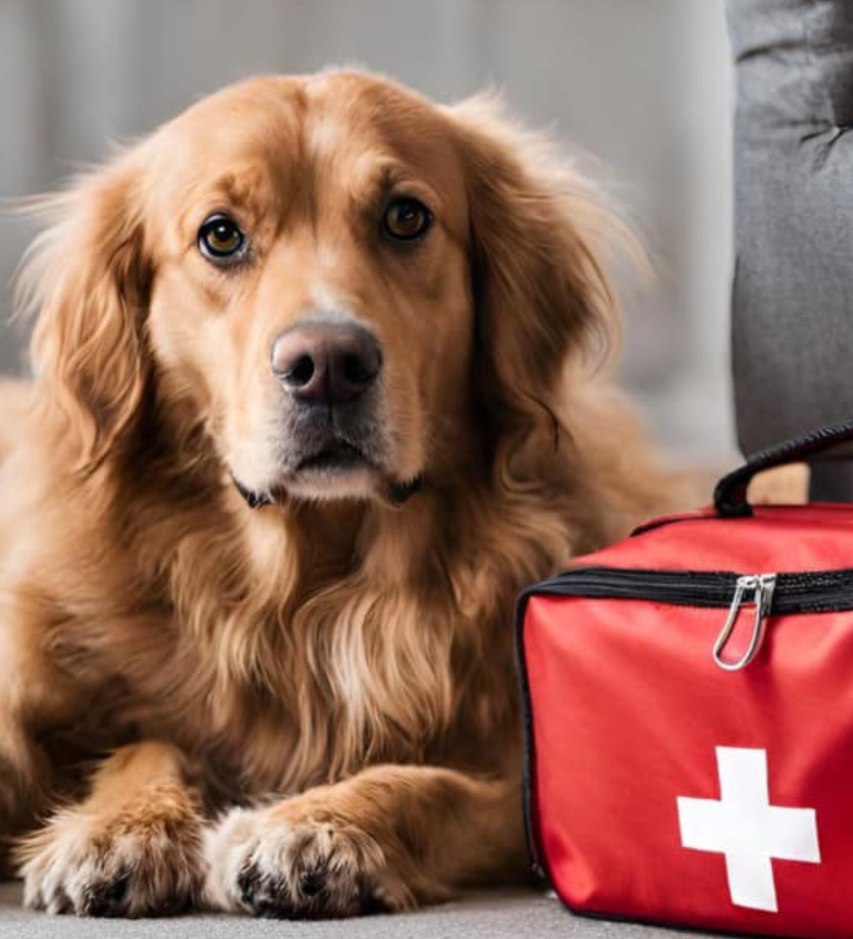
Bleeding Wounds
It only takes 2tsp of blood loss per pound of body weight for an animal to go into shock. The stronger the blood flow the quicker you need to get to a veterinary hospital
Blood Stop Powder: Apply directly to the wound to quickly stop bleeding.
Apply Pressure: Use a compression bandage or gauze pad to press firmly on the wound for 5 minutes.
Elevate the Area: If possible and doesn’t cause pain, elevate the bleeding area above the heart level.
Monitor: Watch for signs of shock and continue to keep the pet calm.
Seek Veterinary Help: Always consult a vet as soon as possible for further care. If bleeding has not stopped for 15 minutes the pet can go into shock.

Slide 21
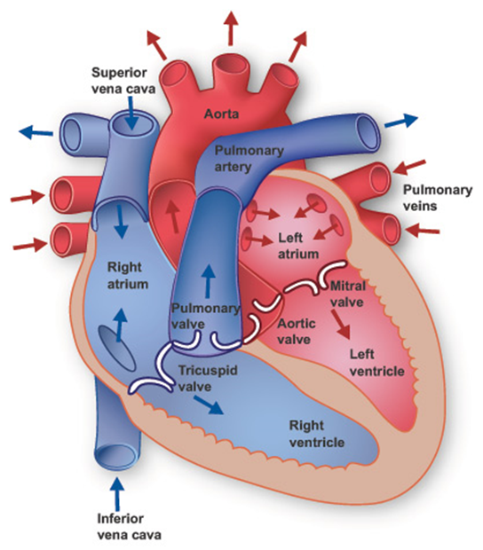
Cardiopulmonary Arrest and Cardiopulmonary Resuscitation
CPA
An event when an animal’s heart stops beating, and their respiratory system stops functioning.
CPR
a procedure that increases cardiac output (amount of blood pumped through the heart) and keeps oxygen delivered to the tissues

Slide 22
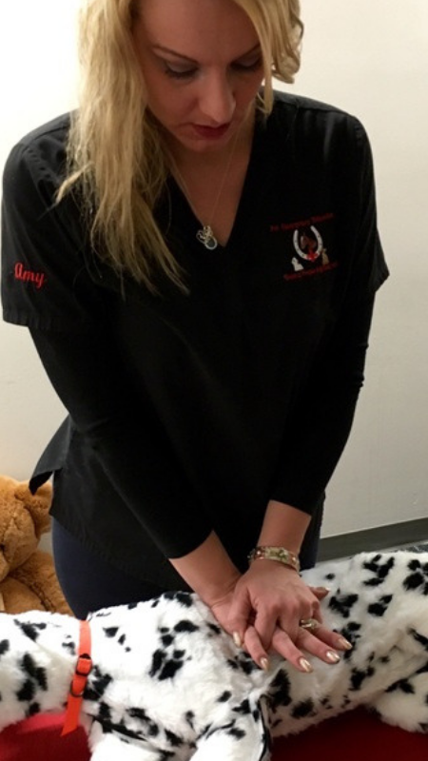
Steps to Performing CPR on Pets
Step 1: Assess if CPR is needed.
Step 2: Conduct a Primary Survey.
Step 3: Position the pet for chest compressions.
Step 4: Perform CPR: 30 compressions and 2 mouth-to-snout breaths. Continue for 2 minutes (approx. 4 cycles).
Step 5: Pause after 2 minutes to check if the pet has revived by check breathing and feel for a pulse.
Step 6: If no revival, repeat CPR for another 2 minutes. If two-person CPR, switch roles after each cycle.

Slide 23
Step 2- Primary Survey Should not take more than 10 seconds to complete
A- Check Airway for Obstructions
B- Check to see if the animal is breathing
C- Check the pulse to see if the animal’s heart is functioning
CPR needs to begin within 10 minutes of the animal going into arrest or it is unlikely it will survive.
After 10 minutes of no CPR an animal will sustain irreversible damage to tissues and organs.

Slide 24
Chest Compressions Most Important Part of CPR
CPR push point
The place you put your hands on your pet’s chest during compressions
The location will depend upon her size and chest shape.
Compression Rate
Chest compressions should be done at a rate of 100–120 compressions per minute.
Compressor Rotation
If possible, a new compressor should take over every 2 minutes to reduce fatigue and the tendency to lean during compressions, preventing full spring-back of the chest.
Compression Depth
The target depth you would compress the chest.
Must be at least one third and no more than one-half the width of the chest at the location of your hands.

Slide 25
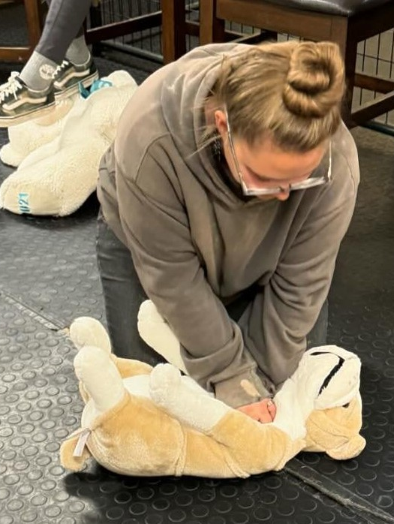
Compression Guidelines
Compress the chest 1/3 to 1/2 of the total width of the chest
Rate of compressions should be between 100-120 bpm no matter the size of the animal
Make sure the chest fully recoils between compressions

Slide 26
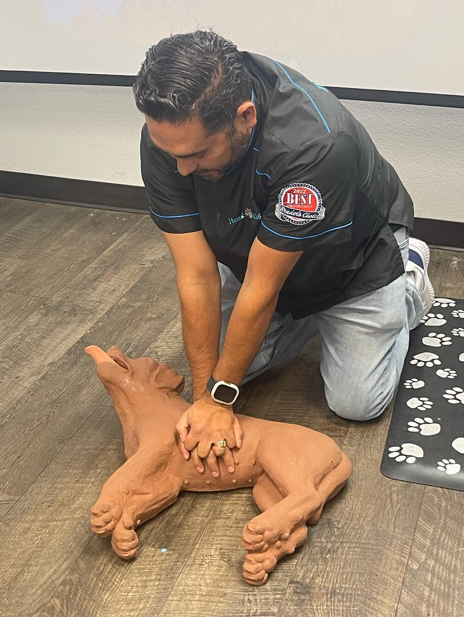
Chest Shape Determines CPR Push Point
There are 2 ways to determine the chest shape of a pet:
Compare the width of the chest to the depth of the chest
Lay your pet on her side and feel the shape of the chest

Slide 27

Keel Chested Position
Keel-chested pets have chests that are deep and narrow.
The CPR push point is directly over the heart.
We find that location by pulling the elbow 1/3 of the way up the chest from the bottom.

Slide 28

Round Chested Pets
Round-chested pets have chests that are approximately as deep as they are wide.
The CPR push point is at the widest point of the chest, which is the point on the chest forming the peak of the dome.

Slide 29

Flat Chested Pets
Flat-chested pets have chests that are wider than they are deep.
Compressions for flat chested pets should be focused directly over the sternum (breast bone) with the dog on its back.
The CPR push point is directly between the front legs.

Slide 30
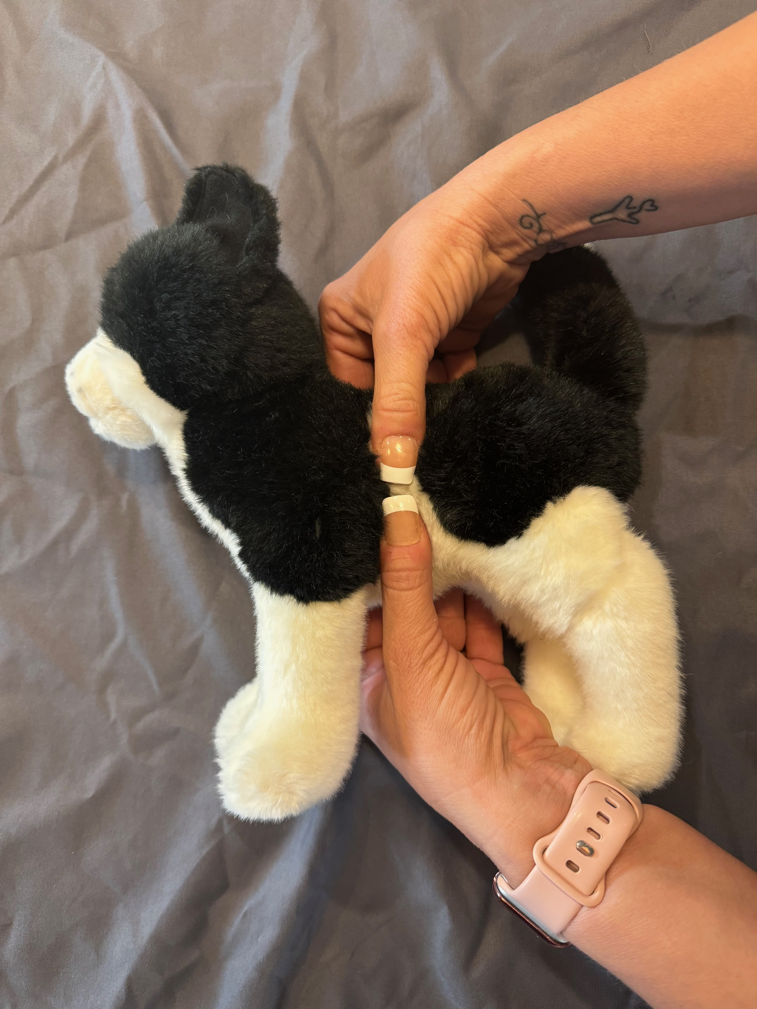
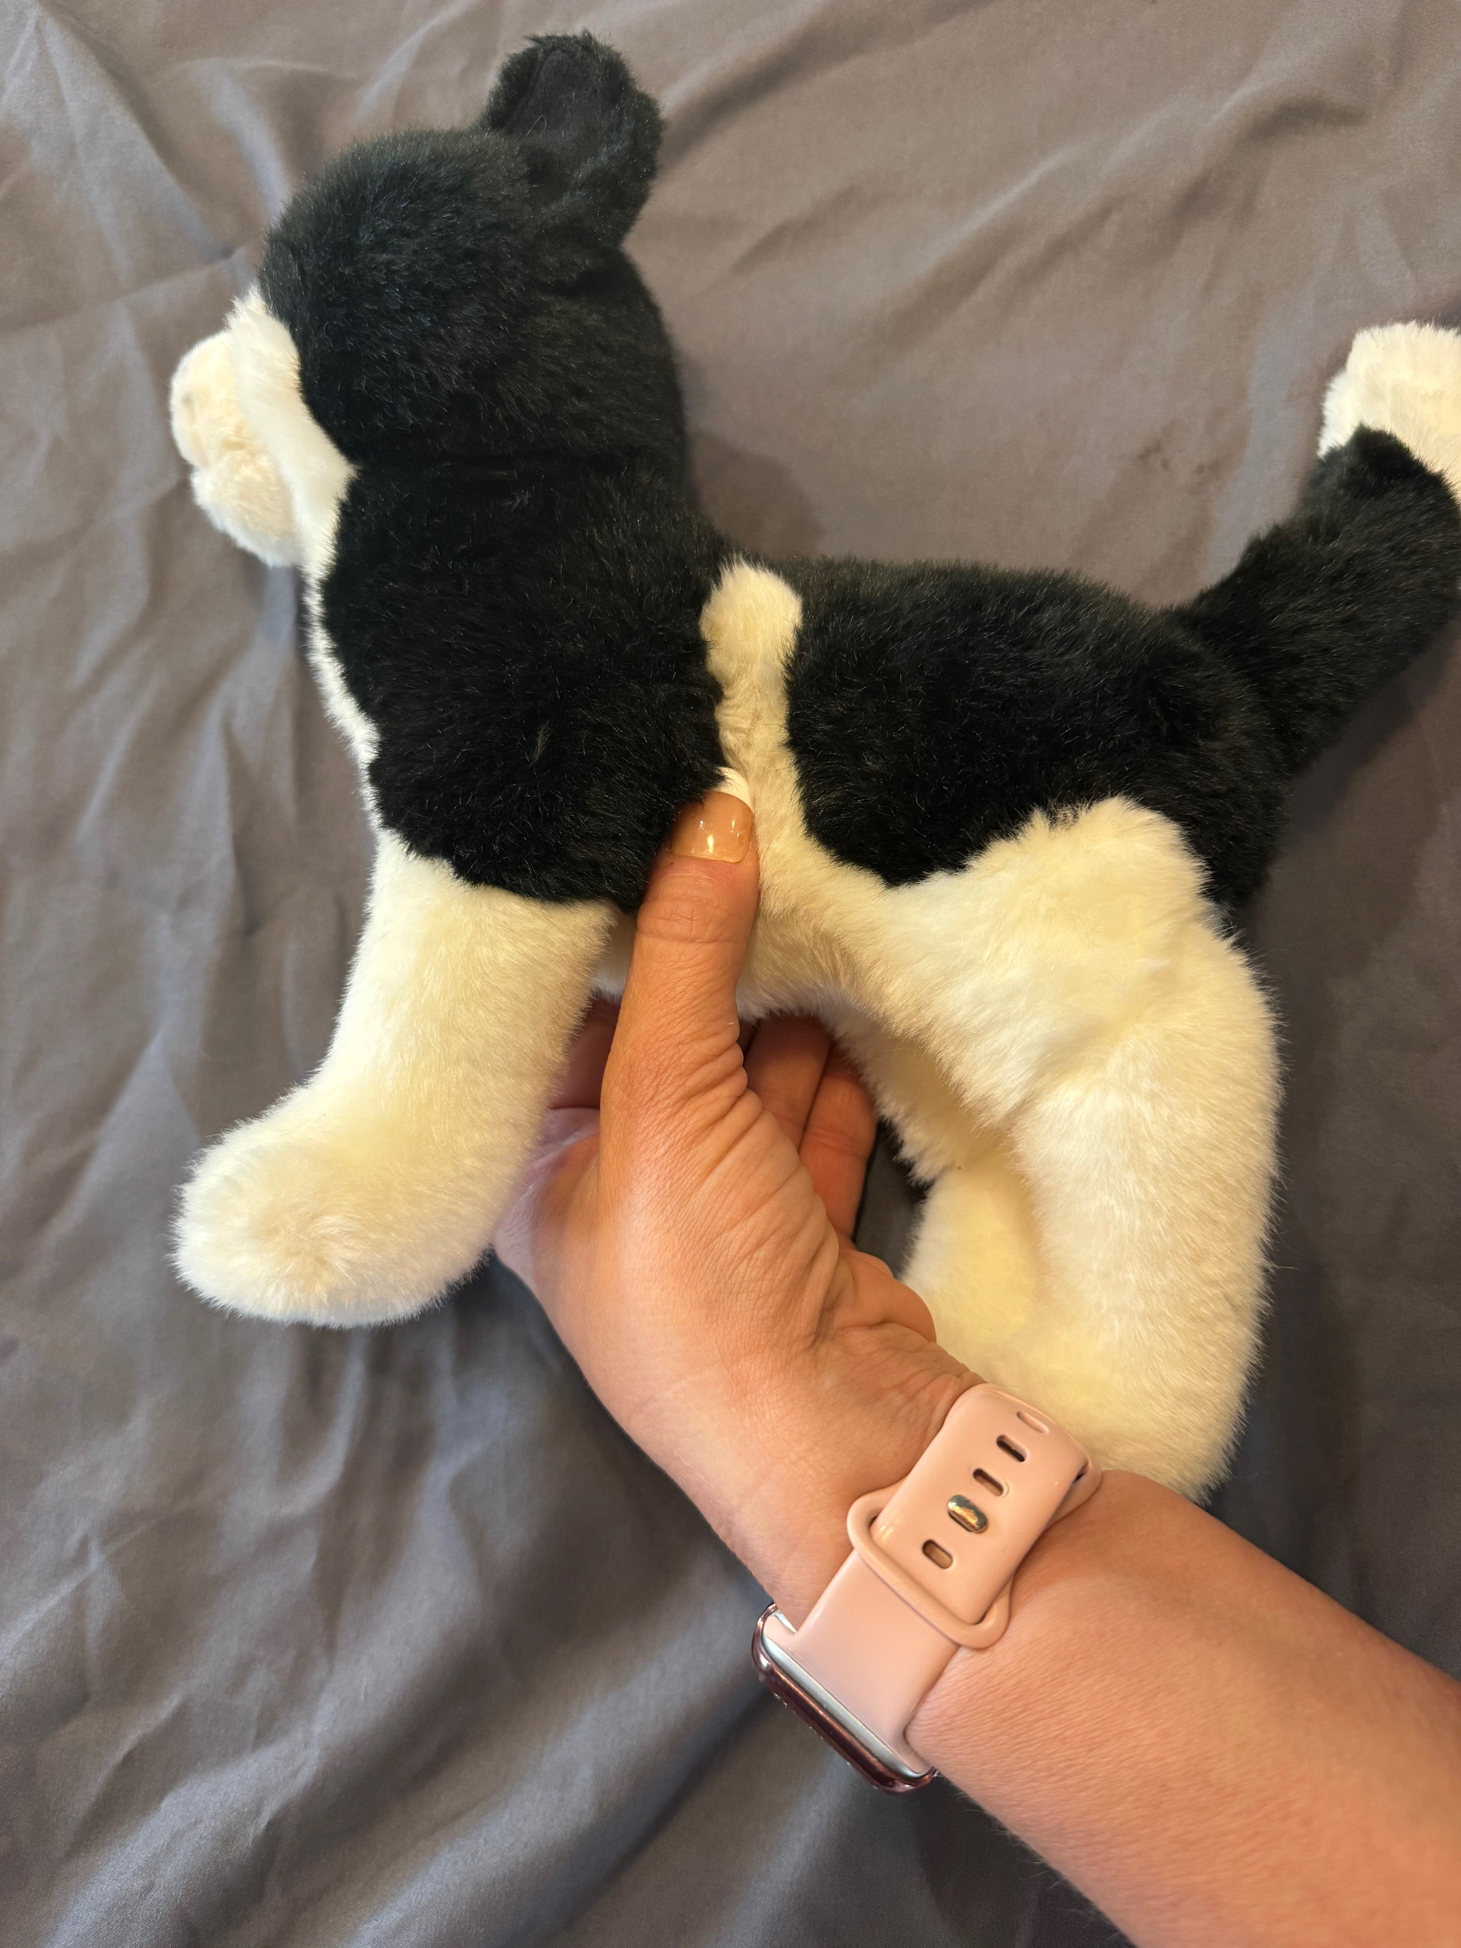
Cats and Small Dogs (puppies and kittens) Pets usually 15 lbs or under
The CPR crush point can be either on the side of the chest or directly over the heart depending on the chest shape of the small pet.
For pets lying on their right side, there are two hand placement options.
If the pet has a small chest, wrap both hands around the chest with your thumbs positioned over the heart.
For narrow-chested pets, use one hand with the thumb positioned over the heart, similar to the technique used for keel-chested pets.
For larger-sized small pets with flat chests: Perform compressions as for flat-chested dogs on their backs.

Slide 31
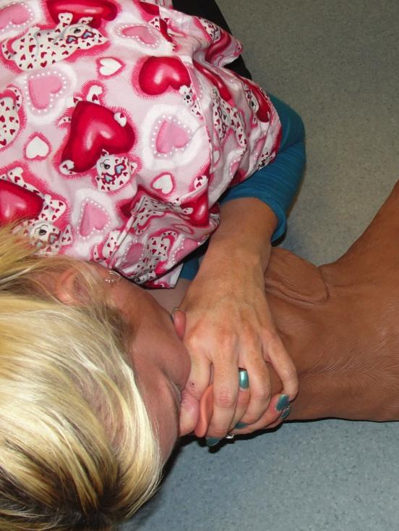
Mouth-to-Snout
Firmly close the pet's mouth
Extend the neck to align the snout with the spine
Make a seal over both nostrils and give 2 quick breaths
Watch the chest to make sure it rises as you give the breaths
Compression to breath ratio is 30 compressions to 2 mouth-to-snout resuscitations

Slide 32
Steps to Performing CPR on Pets
Step 1: Assess if CPR is needed.
Step 2: Conduct a Primary Survey.
Step 3: Position the pet for chest compressions.
Step 4: Perform CPR: 30 compressions and 2 mouth-to-snout breaths. Continue for 2 minutes (approx. 4 cycles).
Step 5: Pause after 2 minutes to check if the pet has revived by check breathing and feel for a pulse.
Step 6: If no revival, repeat CPR for another 2 minutes. If two-person CPR, switch roles after each cycle.

Slide 33



